Slide 1

Terrific Tablets Project:
Test Launch Findings

Slide 2
Summary
We conducted a survey for the 50 customers that participated in our test launch.
For the test launch, we asked the customers to engage with the newly implemented tablets, as if they were participating in a typical restaurant experience. The customers were sent a digital survey after their experience ended.
In the following presentations, you will see the total number of people who selected each possible response and, where applicable, what percentage of the total respondents they represent.

Slide 3
Overview
The project team would like to measure the overall test launch based on the following evaluation indicators:
Average ticket time
Checkout process is seamless and easy to navigate
Less than 5% of customers report technical issues each week
98% order accuracy
Average wait time of ten minutes or less

Slide 4
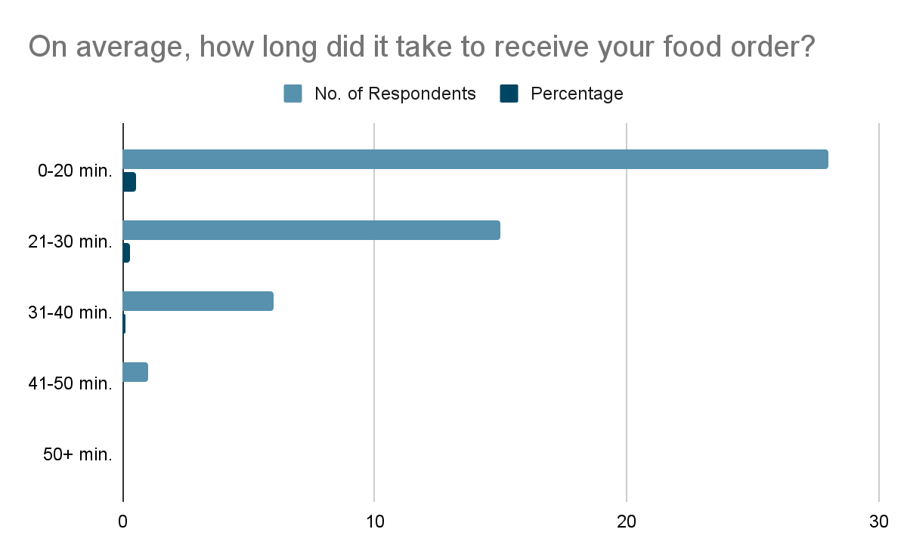
Findings
According to our Test Launch Findings, it turns out that the tablet rollout enabled the ticket time to be less than 20 minutes, a significant difference from our usual 30+ minutes.

Slide 5
Next Steps
Despite the significant decrease in the amount of time it takes for our customer’s orders to arrive to their tables, other findings also suggest that their use of tablets are on a neutral side, meaning, they still manage to receive their orders and be satisfied regardless of the tablet’s seamless features.
One recommendation would be to market the use of tablets more in order to create a more centralized flow of orders from customers directly to the kitchen. It would also reduce the workload of wait staff and ensure that they can efficiently produce the right order to the customers.

Slide 6
Recommendation
The next recommendation would be to improve the operating system of our tablets in order to properly cater the seamless features of the tablet itself and reduce the friction from getting the order that they want and possibly like. One reason for this is that, despite improving the customer satisfaction of our customers, other findings suggest that they still do not have a higher affinity towards appetizers and would prefer dinner instead, thus, failing to attain one of our project goals.

